Slide 1


HR Analytics Project(P375) (Employee Retention)
By Group 5
Mrs. Subhashree Priyadarshini
Mrs. Ganga Rai
Mrs. Shivani Pawar

Slide 2
Project Objective
In this HR Analytics project, we were provided with two datasets in excel format, each containing 50,000 rows.
The objective was to analyze the data and derive insights to assist the HR team in employee retention.
We utilized MS-Excel and MySQL for the analysis, performing calculations, merging datasets, and creating interactive dashboards.
Additionally, we prepared dashboards using Excel, Power BI, and Tableau tools.

Slide 3









KPI’S
1.Average Attrition rate for all Departments
2.Average Hourly rate of Male Research Scientist
3.Attrition rate Vs Monthly income stats
4.Average working years for each Department
5.Job Role Vs Work life balance
6.Attrition rate Vs Year since last promotion relation

Slide 4
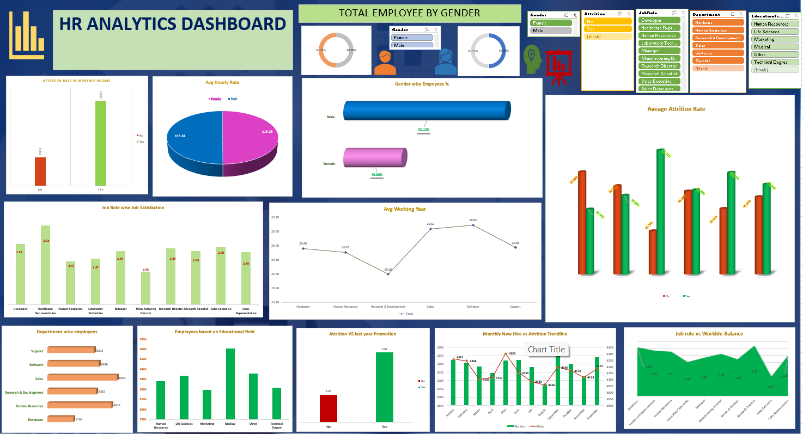
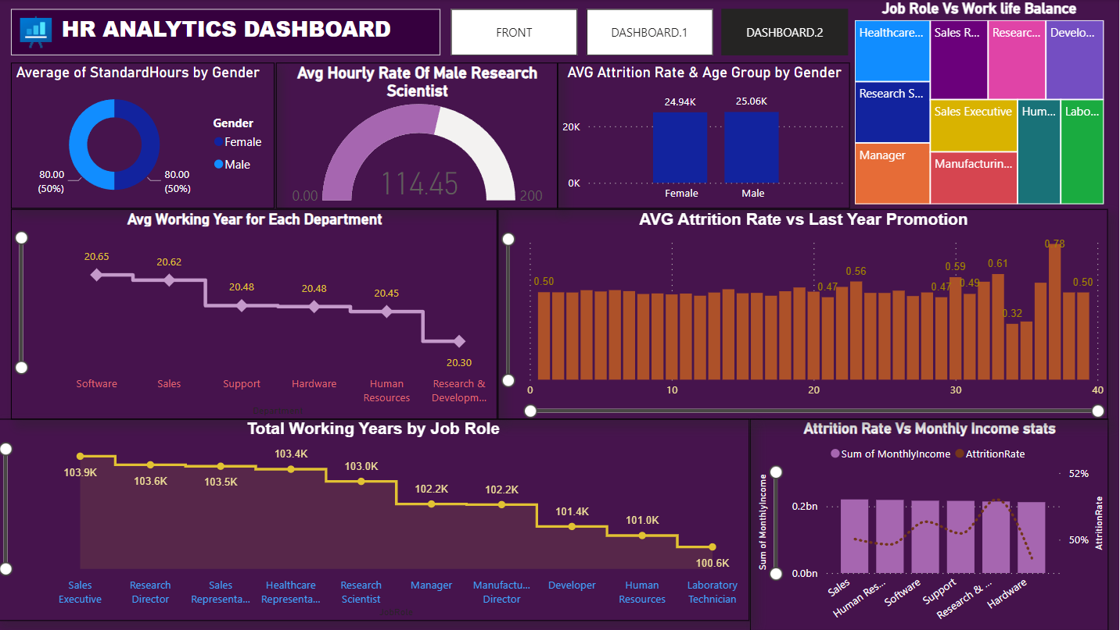
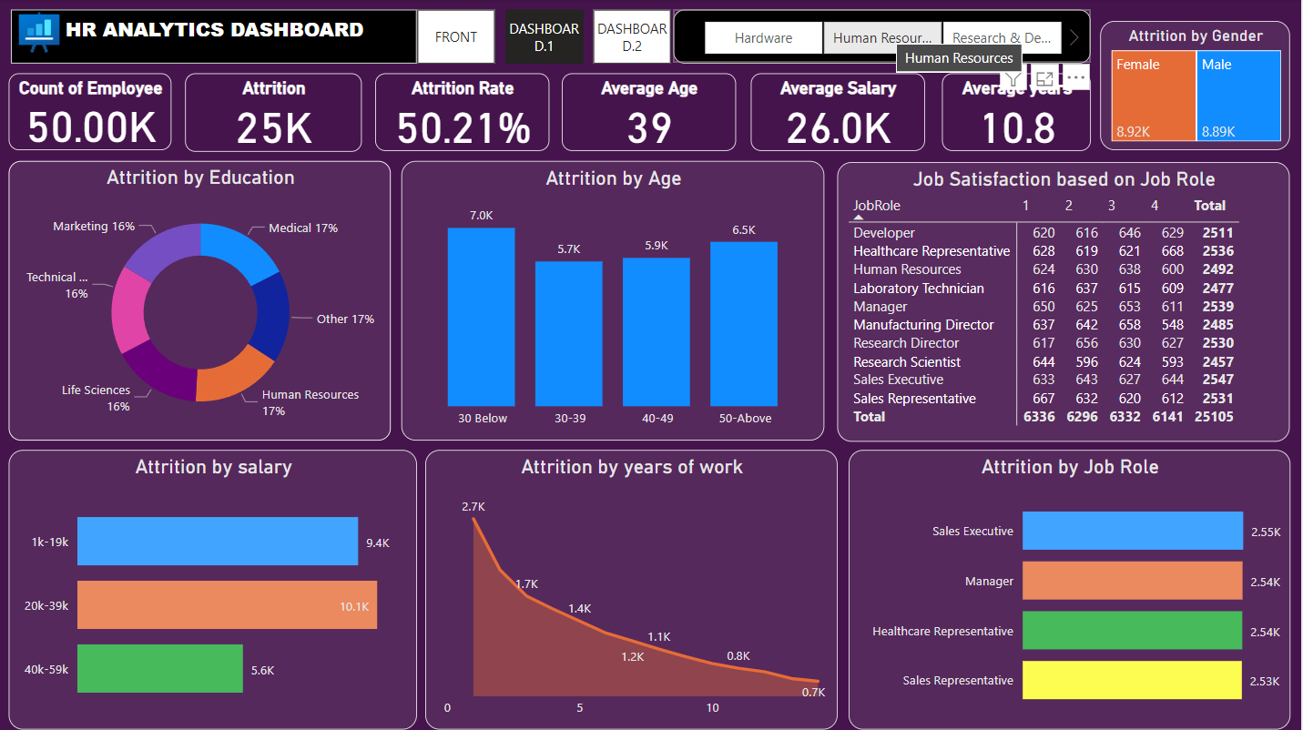
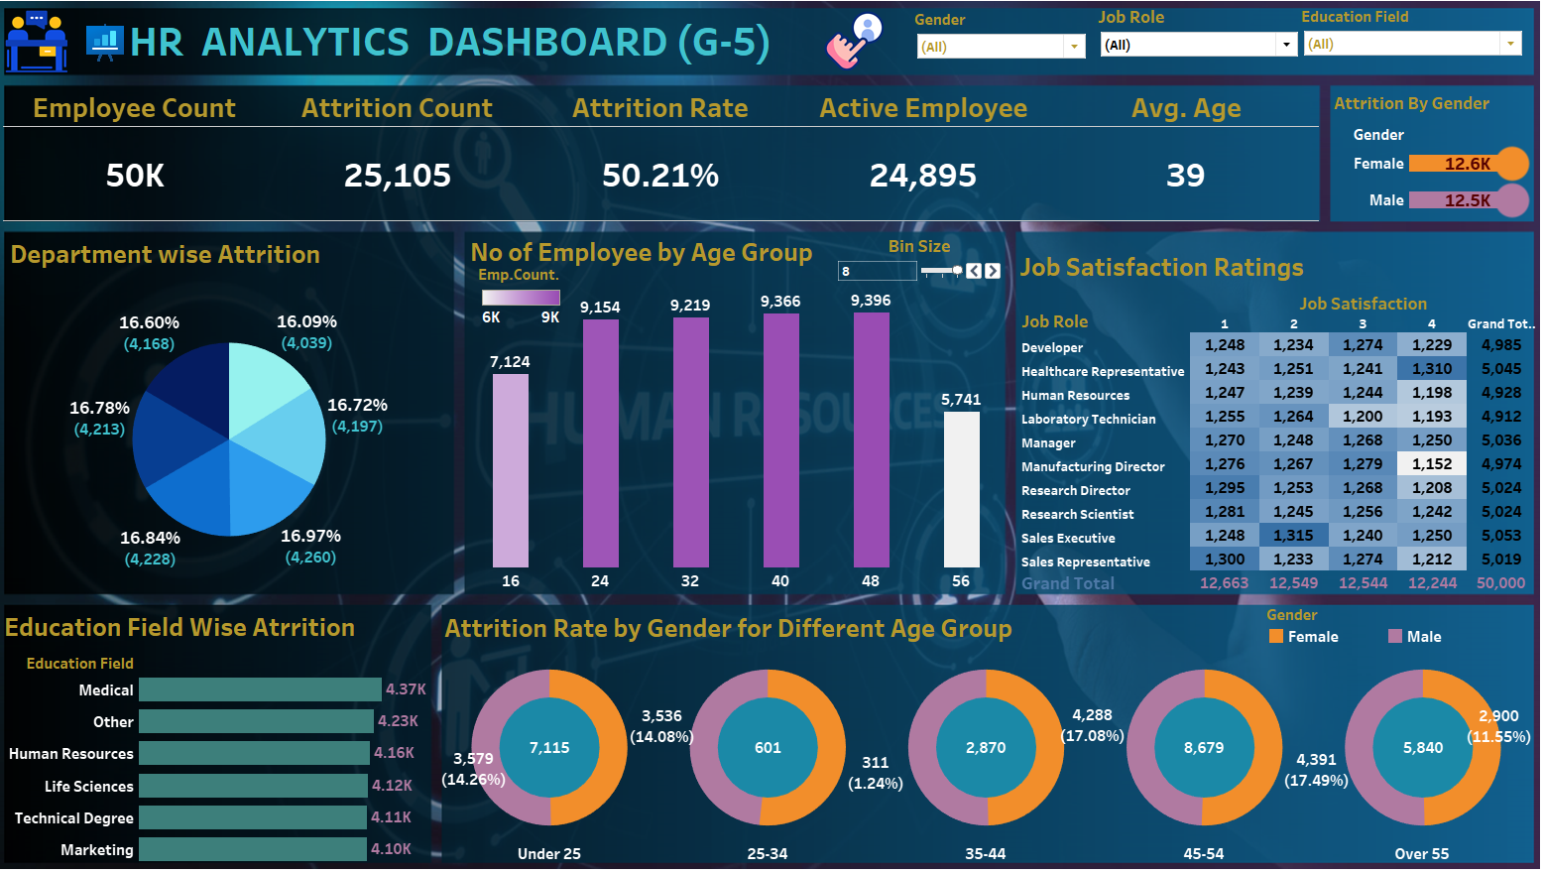
DASHBOARDS CLIP BY EACH BI - TOOL

Slide 5
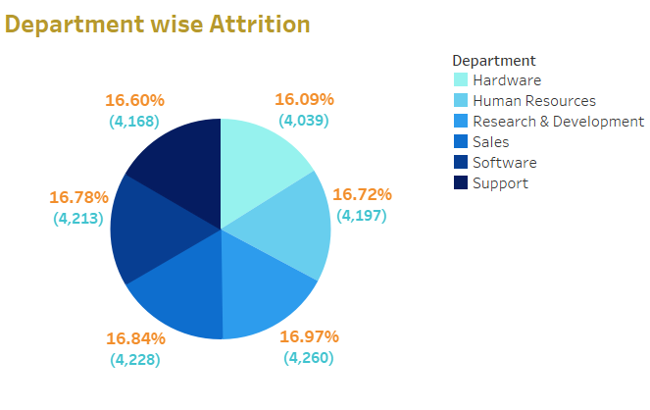
KPI-1
Average Attrition rate for all Departments:
* We had 50,000 employee's data with us. Out of them 25,105 quit the job. So, it comes around 50.21%.
* In this chart we can see that almost equal employees from each department have left the
job.
* The attrition rate is high in Research & Development department among all the departments followed by software department.

Slide 6
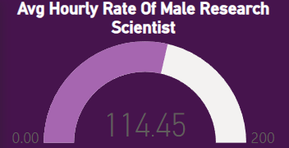
KPI-2
Average hourly rate of male research scientist:
The average hourly rate of male research scientist is around 114.45.

Slide 7
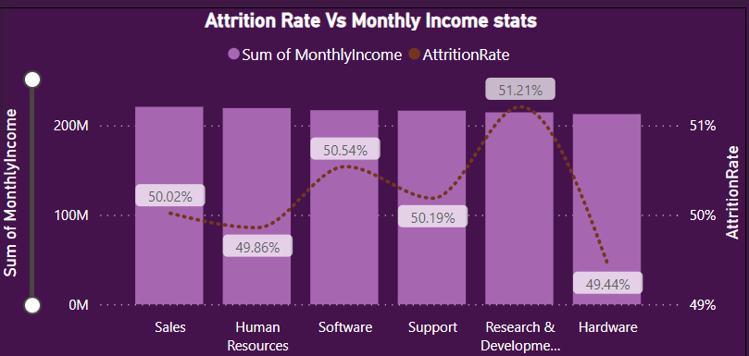
KPI-3
Attrition rate Vs Monthly income stats
In this chart we can see how monthly income is affecting attrition.
The data reveals a consistent attrition rate of around 50% across various monthly brackets.
Monthly income range from 100M-200M has seen highest attrition rate which is 51.21%
And lowest attrition is in range between 0M-100M which is 49.44%
As the salary increases there is more attrition.

Slide 8
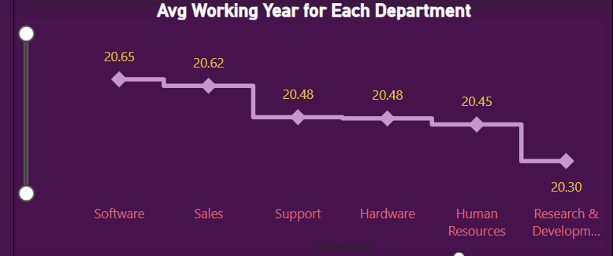
KPI-4
Average working years for each Department:
Here, we observe a consistency in working hours across departments, averaging approximately 20.45 hours.
The Software Department stands out with employees working longer hours compared to other departments."

Slide 9
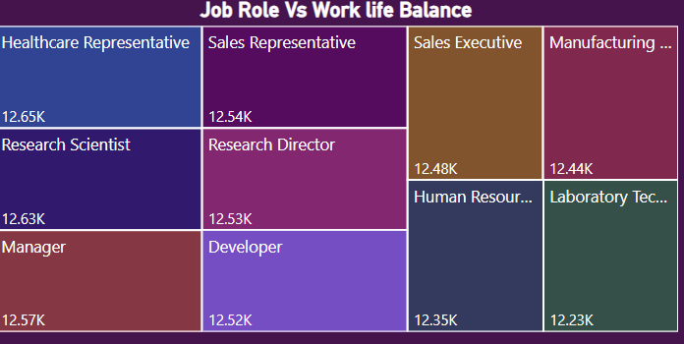
KPI-5
Job Role Vs Work life balance:
This Tree Map represents the ratings given by employees to the work life balance respective to their job role.
In comparing job roles and work-life balance, we can conclude the following:
For Manufacturing Directors, more employees seem to have given average ratings, indicating that they can moderately manage both their job and work-life.
Healthcare Representatives show a more even distribution, suggesting that they are trying to balance both aspects according to their individual circumstances.
Each employee appears to have different strategies for managing both job and work-life.

Slide 10
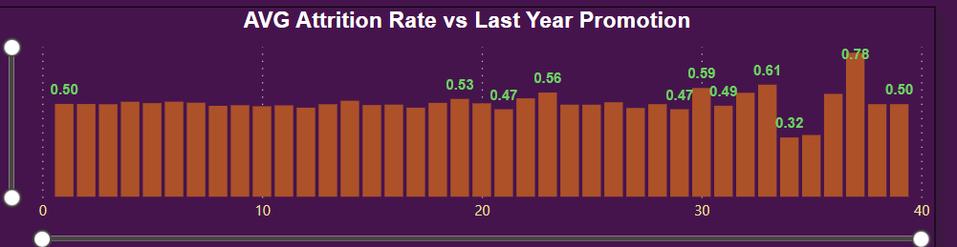
KPI-6
Attrition rate Vs Year since last promotion relation:
The data indicates a relatively stable attrition rate, hovering around 50%, across different ranges of years since the last promotion.
The attrition rate was higher in the 31-40 years since the last promotion group.

Slide 11
INSIGHTS FROM HR ANALYTICS PROJECT
By department, it is observed that the Sales department has a higher count of employees compared to other departments. Employees in this department express higher levels of satisfaction in terms of their job, work environment, involvement, relationships, performance, and work-life balance.
Looking at job roles, Healthcare Representatives have a higher count of employees compared to other job roles. Employees in this role report higher levels of satisfaction regarding their job, work environment, involvement, relationships, performance, and work-life balance.
Equal number of attrition rate in both gender.

Slide 12
WHAT YOU MAY DO TO SCALEUP THE BUSINESS???
To improve overall work-life balance satisfaction, organizations may need to adopt a holistic approach that considers factors beyond job roles. Employee feedback, regular assessments and flexibility initiatives can contribute to creating a work environment that supports a healthier balance between professional and personal life.
Identifying the root cause of turnover, addressing employee concerns and enhancing overall job satisfaction are critical for stabilizing the workforce and sustaining organizational success.
Conduct thorough exit interviews to gather insights from departing employees.
Recognize and reward employees for their contributions and achievements.
Feeling valued and appreciated can contribute to higher employee retention.

Slide 13

Thank you !

